Slide 1

CS 533 INTRO TO DATA SCIENCE
Michael Ekstrand

Slide 2
PIPELINES AND TRANSFORMERS

Slide 3

Learning Outcomes
Use a SciKit-Learn Pipeline to combine feature transforms and prediction
Photo by Danil Sorokin on Unsplash

Slide 4
Pipelines
Our data often takes the form of a pipeline:
Transform features
Fit model
Prediction then requires:
Transform features
Generate predictions

Slide 5
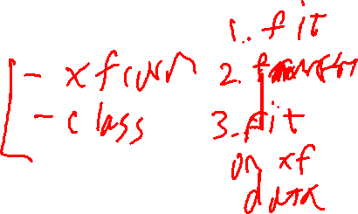
SciKit-Learn
Pipeline: create a sequence of ‘models’
Typically one or more transforms followed by regressor or classifier
Fit the pipeline and it will fit its inner models

Slide 6
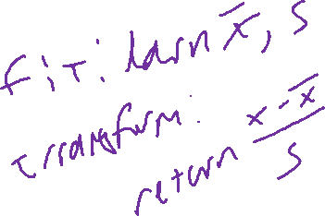
Transformer
The SciKit-learn use case so far has been:
Train data with fit(X, y)
Generate predictions with predict(X)
Transformers have a third method: transform(X)
Learn transformation parameters with fit(X) (y is ignored)
Transform with transform(X)
Only apply to input features – not targets

Slide 7
ColumnTransformer
Transformers apply to all columns
Good when they’re all numerics
ColumnTransformer transforms different columns differently
List of (name, transformer, column) triples for columns
Some transformers take 1 column, some a list of columns
remainder option for remaining columns (‘drop’, transform, etc.)

Slide 8
Useful Transformers
StandardScaler – standardizes variables
PowerTransformer – applies power transformations
Binarizer – converts numeric to 0/1 with threshold
OneHotEncoder – encodes categorical as dummy
FunctionTransformer – transform with a function you write

Slide 9
Transforming Outcomes
Transformers only apply to features
The TransformedTargetRegressor class transforms target variables
Wraps an underlying predictor
Transforms target before calling inner ‘fit’ or ‘predict’
Un-transforms the results of ‘predict’

Slide 10

Wrapping Up
Pipelines let us combine multiple data steps into a single operation.
This facilitates applying train data transforms to test data.
Pay very close attention to defaults in SciKit-Learn.
Photo by Fabio Bracht on Unsplash

